Slide 1

Game ‘N Watch
  Andrew Storrow
  Ben Roux
  John Reese

Slide 2
Project Overview
Lists existing and upcoming video games
  Records include: Genre, Platform, Publisher, Developer, etc…
Supports all major gaming platforms
Allows user to track games of interest
Allows networking between friends

Slide 3
Technologies Used
Presentation Tier
  JSP / HTML
Application Tier
  Java
  Spring Framework
Database Tier
  mySQL

Slide 4
Design Tradeoffs
Maintain strong OO architecture
Highly coupled GameService class to reduce Presentation -> Application tier connections

Slide 5
Spring Framework
Spring, MVC web pages constructed within the presentation tier
GameService, acting as model, facades application tier
Integrated JDBC communication with DBMS

Slide 6
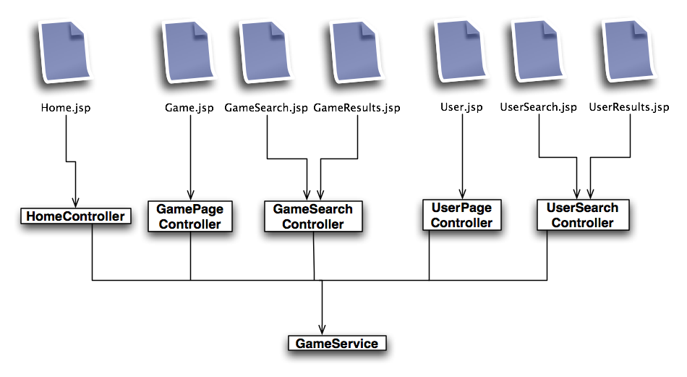
Presentation Tier

Slide 7
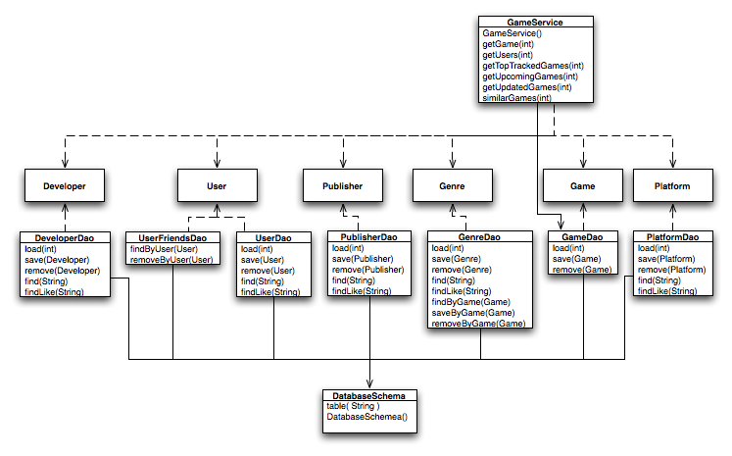
Application Tier

Slide 8
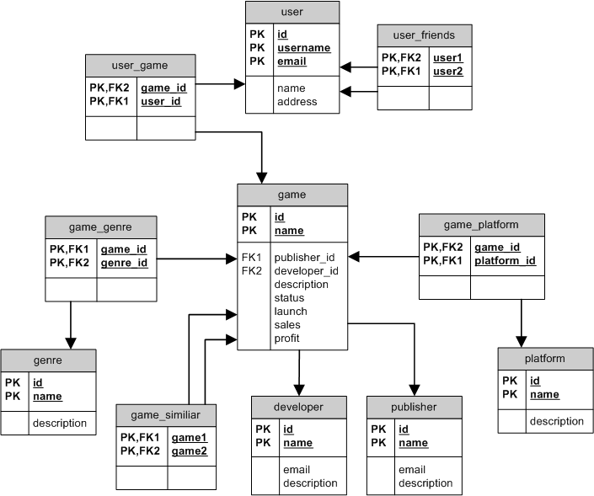
Database Model

Slide 9
Functional Scope
Overview of all games
Get information for specific games
View users' profiles
Search for games by name

Slide 10
Reflection
Secured technologies and hardware early on
Resisting over-engineering
Tutorials ambiguously useful
Mostly tedious work

Slide 11
Identified Risks
Spring Framework
  Spring-style MVC
  Controller classes paired with XML files
Initial Project Scope
  Financial information tracking
  Robust user-to-user interaction

Slide 12
Demo

Slide 13
Questions?

